Slide 1
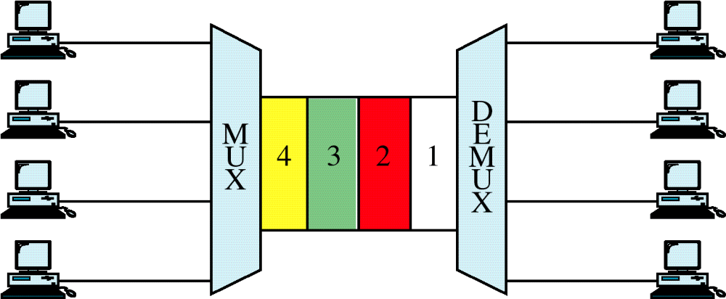
Figure 8-8
TDM
WCB/McGraw-Hill
© The McGraw-Hill Companies, Inc., 1998

Slide 2
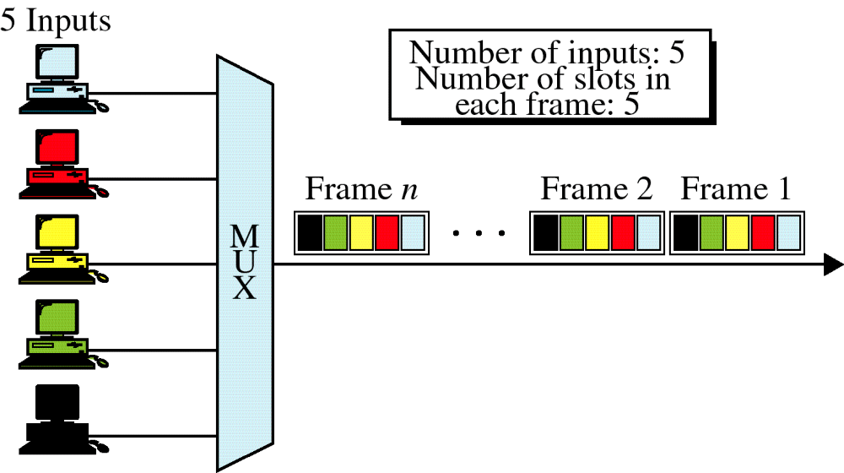
Figure 8-9
Synchronous TDM
WCB/McGraw-Hill
© The McGraw-Hill Companies, Inc., 1998

Slide 3
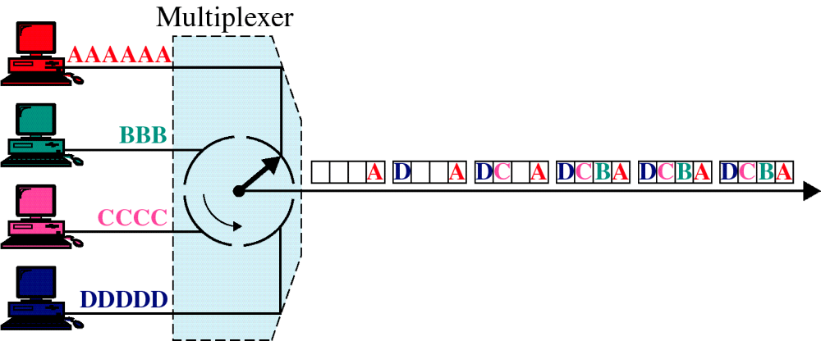
Figure 8-10
TDM, Multiplexing
WCB/McGraw-Hill
© The McGraw-Hill Companies, Inc., 1998

Slide 4
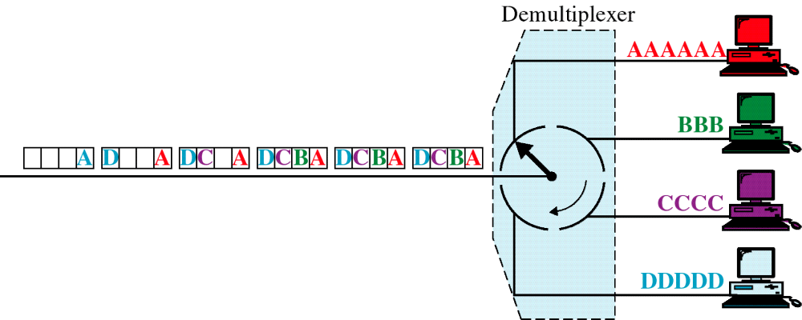
Figure 8-11
TDM, Demultiplexing
WCB/McGraw-Hill
© The McGraw-Hill Companies, Inc., 1998

Slide 5
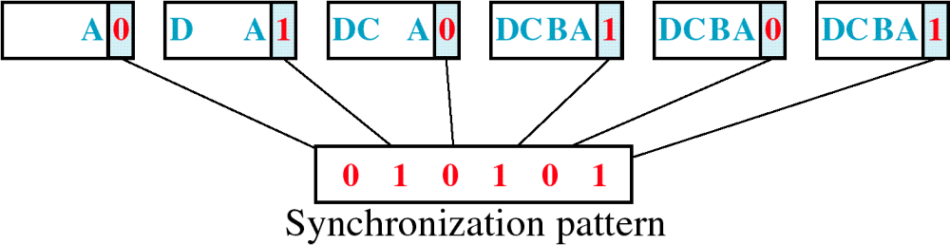
Figure 8-12
Framing Bits
WCB/McGraw-Hill
© The McGraw-Hill Companies, Inc., 1998

Slide 6
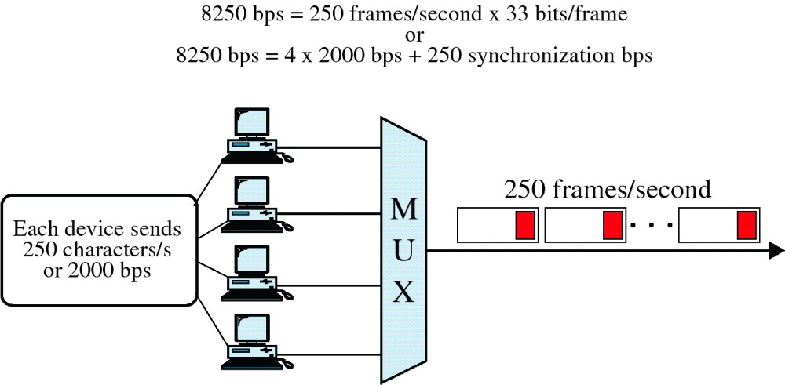
Figure 8-13
Data Rate
WCB/McGraw-Hill
© The McGraw-Hill Companies, Inc., 1998

Slide 7
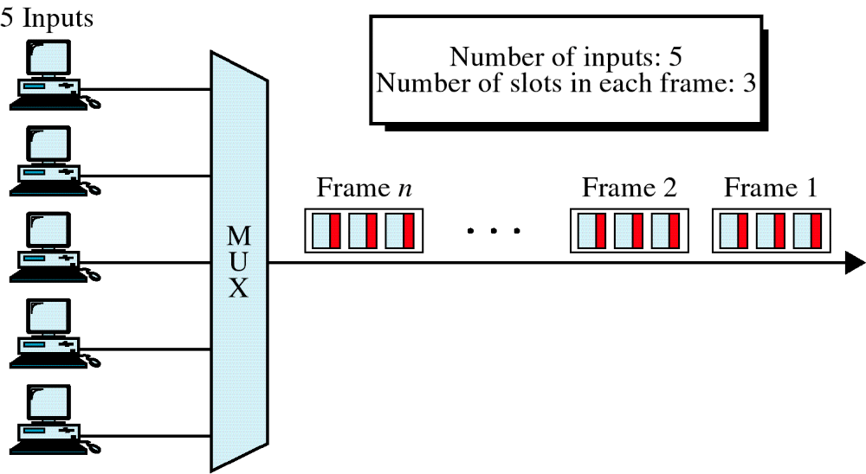
Figure 8-14
Asynchronous TDM
WCB/McGraw-Hill
© The McGraw-Hill Companies, Inc., 1998

Slide 8
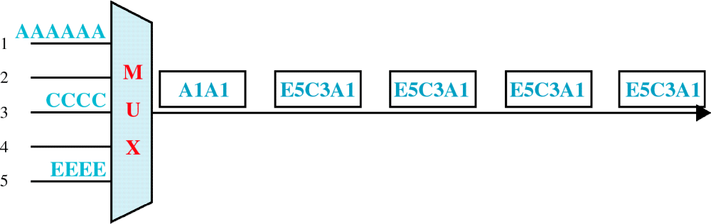
Figure 8-15
Frames and Addresses
a. Only three lines sending data
WCB/McGraw-Hill
© The McGraw-Hill Companies, Inc., 1998

Slide 9
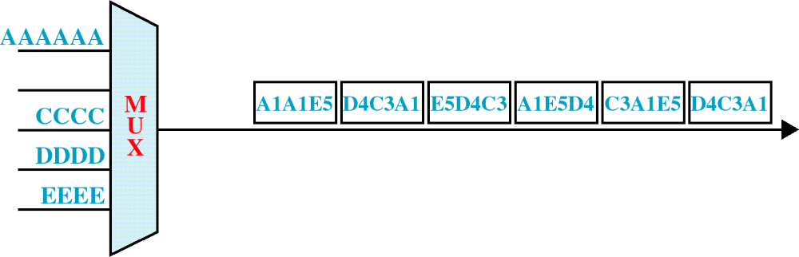
Figure 8-15-continued
Frames and Addresses
b. Only four lines sending data
WCB/McGraw-Hill
© The McGraw-Hill Companies, Inc., 1998

Slide 10
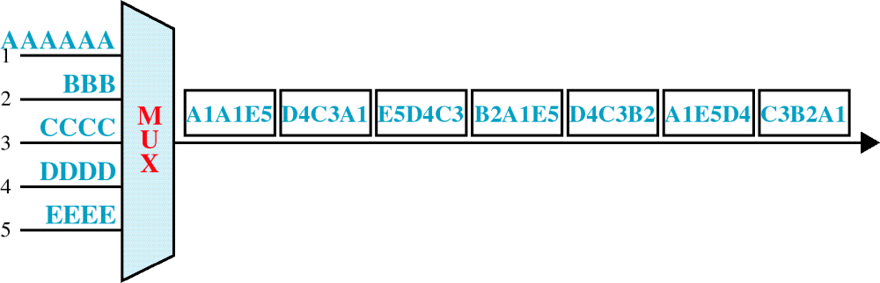
Figure 8-15-continued
Frames and Addresses
c. All five lines sending data
WCB/McGraw-Hill
© The McGraw-Hill Companies, Inc., 1998

Slide 11
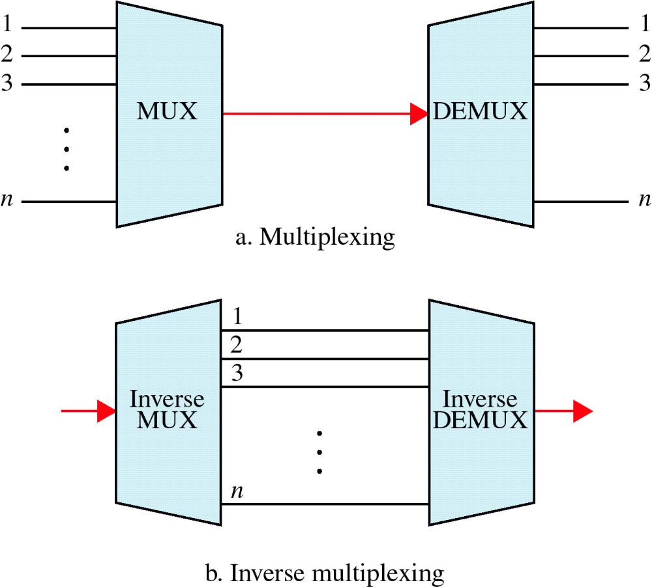
Figure 8-16
Multiplexing and Inverse Multiplexing
WCB/McGraw-Hill
© The McGraw-Hill Companies, Inc., 1998

